Slide 1

SIGN LANGUAGE TO TEXT AND SPEECH TRANSLATION USING COMPUTER VISION AND DEEP LEARNING
BY:
EDWIN MUTWO ENE221-0101/2017
KIMUTAI SAMUEL MAIYO ENE221-0094/2017
Supervisor:
MR. STEPHEN KIAMBI

Slide 2
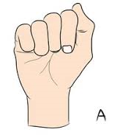
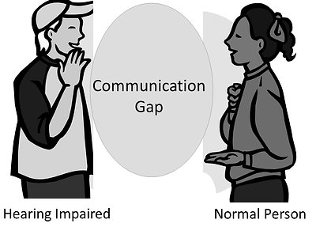
INTRODUCTION
A person with a speech impairment has a difficult time communicating with the general population.
This communication gap exists when a deaf person communicates using sign language that is incomprehensible to a non-deaf person.

Slide 3
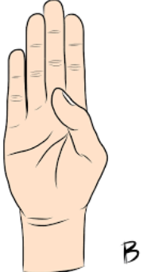
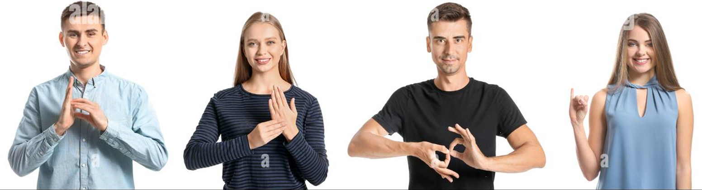
INTRODUCTION
The major mode of communication between hearing-impaired people and other populations is sign language (SL), which is represented through both manual (body and hand motions) and non-manual (facial expressions) elements.
These characteristics are used to generate utterances, which communicate the meaning of words or phrases.

Slide 4

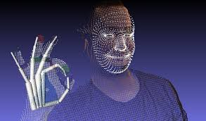
INTRODUCTION
Our project aims to break down communication barriers.
Approach: Machine learning

Slide 5
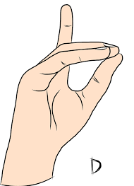
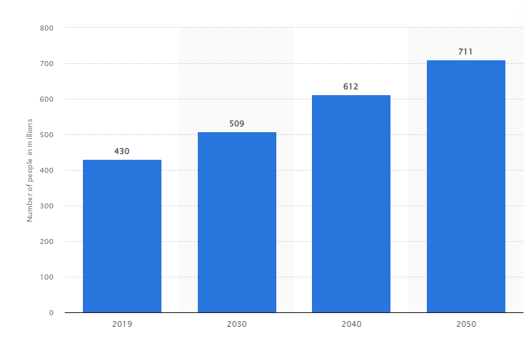
PROBLEM STATEMENT
Over 5% of the world's population, approximately 430 million individuals, suffer from hearing loss, according to the World Health Organization (WHO)^{[1] .}
Also, according to World Health Organization, 700 million people will have hearing problems by 2050.

Slide 6
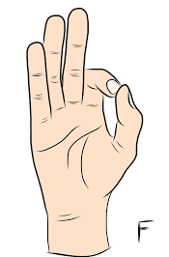
OBJECTIVES
Main Objective
To develop a model that translates sign language to text and speech.
Specific Objectives
To build a dataset for use in training and testing of the model.
To train and test the model to achieve the highest level of accuracy.
To convert the translated text to speech.

Slide 7
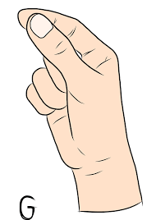
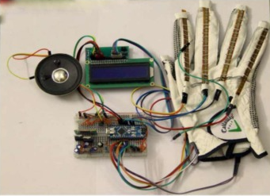
LITERATURE REVIEW
Some of the related works done on sign language to text and speech translation include:
Glove-based gesture recognition systems
The glove-based system is a wireless wearable computer that incorporates an Arduino Nano controller, IMU and flex sensors, as well as gesture recognition software^{[2]}

Slide 8
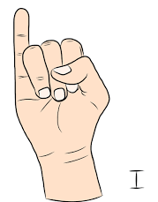
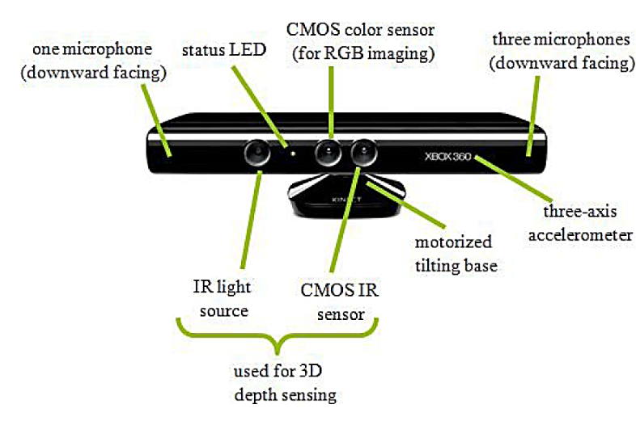
LITERATURE REVIEW
Kinect-based gesture recognition systems
A Microsoft Kinect is a motion camera that records users' movements in real time. Kinect has primarily been used for gaming in recent years ^{[3].}
It is less commonly utilized for commercial purposes than the camera technique due to increased maintenance and overall costs.

Slide 9
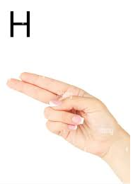
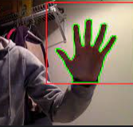
LITERATURE REVIEW
Camera-based gesture recognition systems
Camera-based picture or video capturing is one of the most effective approaches in sign language interpreting systems^{[4]}.
Videos are recorded first, then broken into picture frames that can be uploaded to the system for further processing and interpretation.
As a result, the system receives an image stream, which is then processed in various ways depending on the application.

Slide 10
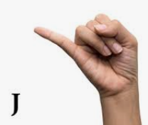
MATERIALS AND METHODS
METHODS
Sign Language Detection Model
Data Collection
This is the first step towards creating a working model.
The aim of this step is to collect the dataset that will be used in training and testing the model.
These images collected depict the signs of the letters of the alphabet and numbers made by the signer by hand.

Slide 11
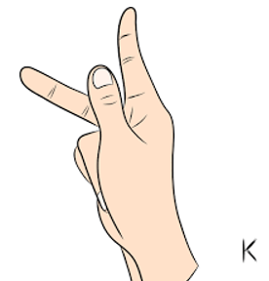
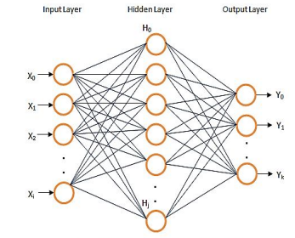
MATERIALS AND METHODS
Artificial Neural Network
Artificial neural networks are used for classification.
Type of ANN used is Multilayer Perceptron(MLP)

Slide 12
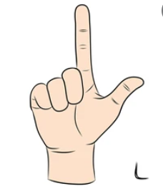
MATERIALS AND METHODS
Training and testing the model
Here we will use the train/test split model validation technique.
80% of the dataset will be used for training while 20% will be used for validation and testing.
The neural network will be trained using the backpropagation approach utilizing a collection of labeled training examples provided.
Backpropagation is a supervised learning algorithm used to train Multi-Layer Perceptrons.

Slide 13
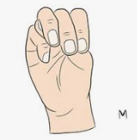
MATERIALS AND METHODS Real Time Sign Language Architecture
Image Acquisition from the Web camera
Pre-Processing
Hand Tracking
Final Output as Text and Speech
Feature Extraction

Slide 14
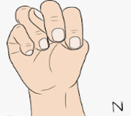
METHODS AND MATERIALS
MATERIALS
Hardware Requirements
The following list summarizes the system's minimum hardware requirements:
Image sensor
CPU: Intel Core I3 or above
Operation Speed: 2.0GHz or above
RAM: 4GB or above
Hard disk: 512gb or above

Slide 15
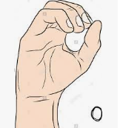

METHODS AND MATERIALS
Language
The language that will be used is Python.
Python is a dynamic language which helps to write the code in fewer lines.
It is widely used in machine learning and for producing deep learning algorithm.
It also includes frameworks such as Tensorflow and Keras, as well as libraries such as NumPy, Scipy, and others.

Slide 16
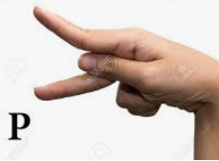
METHODS AND MATERIALS
Libraries and Platforms
Tensorflow
Keras
iii. OpenCV
iv. Jupyter Notebook

Slide 17
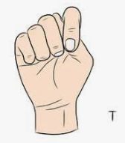
CONCLUSION
The proposed system enables people who do not understand sign language to communicate effectively with individuals who have a hearing disability.
It improves the social life of the deaf since they are able to communicate effectively with other people, thus they can express themselves.
It gives sound to the deaf.

